Slide 1
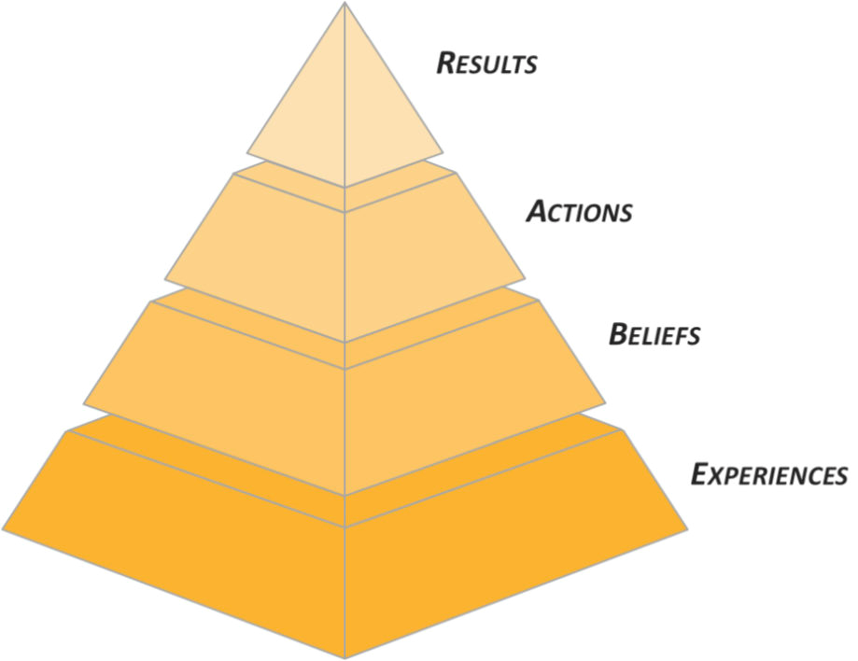

Reading Skill Building Factors involved in effective reading
Notes:
Title

Slide 2
Reading Skill Building
Reading skill separates the "passive" unskilled reader from the "active" readers.
Skilled readers don't just read, they interact with the text.
Inner Monologue
Notes:
Inner Monologue :
An internal monologue, also called self-talk or inner speech, is a person's inner voice which provides a running verbal monologue of thoughts while they are conscious. It is usually tied to a person's sense of self.

Slide 3

What is reading?
Reading skills refer to the specific abilities that enable a person to read with independence and interact with the message.
Students at the university do a lot of reading unlike in secondary school.
Some tips to help in having good reading skills are active reading and styles of reading.
Notes:
Reading is the complex cognitive process of decoding symbols to derive meaning. It is a form of language processing. Success in this process is measured as reading comprehension. Reading is a means for language acquisition, communication, and sharing information and ideas.
The symbols are typically visual but may be tactile. Like all languages, it is a complex interaction between text and reader, shaped by prior knowledge, experiences, attitude, and the language community—which is culturally and socially situated.
The reading process requires continuous practice, development, and refinement. Reading requires creativity and critical analysis. Consumers of literature deviate from literal words to create images that make sense to them in the unfamiliar places the texts describe. Because reading is a complex process, it cannot be controlled or restricted to one or two interpretations.
There are no concrete laws in reading, but rather it provides readers an escape to produce their own products introspectively. This promotes deep exploration of texts during interpretation. Readers use a variety of reading strategies to decode and comprehend. Readers may use context clues to identify the meaning of unknown words. Readers integrate the words they have read into their existing framework of knowledge or schema.

Slide 4

The Types Of Reading Skill
Extensive reading.
Intensive reading.
Receptive reading.
Skimming.
Scanning.
Notes:
The Types Of Reading Skill
Extensive reading.
Intensive reading.
Receptive reading.
Skimming.
Scanning.

Slide 5

Extensive Reading
In extensive reading, the readers to choose for themselves what they read and to do so pleasure and general language improvement.
It is important for the development of students' word recognition and for their improvement as readers overall.
Notes:
Extensive Reading

Slide 6
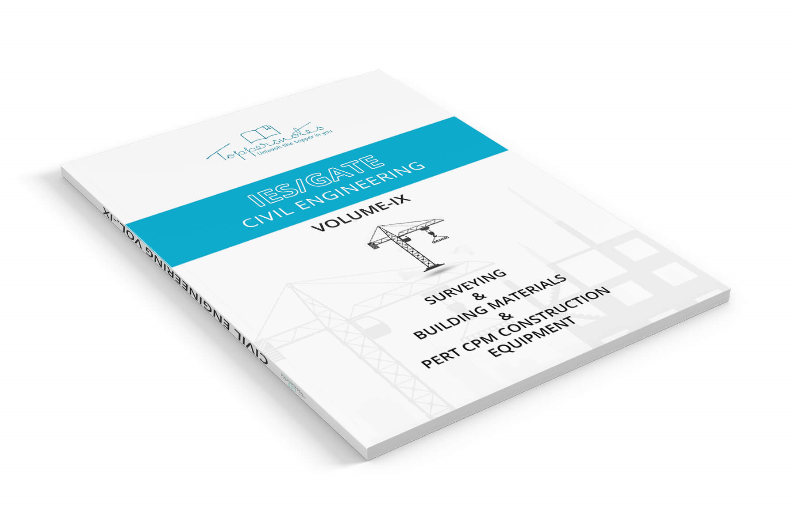
Extensive Reading Materials
Written materials for extensive reading are often referred to as graded readers or simplified readers.
They can take the form of original fiction and non-fiction books as well as simplifications of established works of literature.
Notes:
Extensive Reading Materials

Slide 7
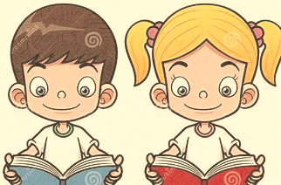
Intensive Reading
It is designed to enable students to develop specific receptive skills such as:
Reading for gist (or general understanding-often called skimming).
Reading for specific information (often called scanning).
Reading for detailed comprehension or reading for inference (what's behind the word) and attitude.
Notes:
Intensive reading ‘ calls attention to grammatical forms, discourse makers and other surface structure details for the purpose of understanding
Literal meaning, implications, rhetorical relationships
Intensive Reading
It is designed to enable students to develop specific receptive skills such as:
Reading for gist (or general understanding-often called skimming).
Reading for specific information (often called scanning).
Reading for detailed comprehension or reading for inference (what's behind the word) and attitude.

Slide 8
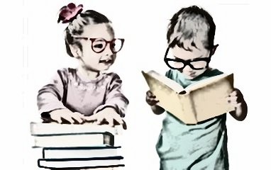
The Other Kinds Or Styles Of Reading
Receptive reading:
The emphasis is on the informational content. This is sometimes referred to extensive reading, although the term “extensive” can be misleading as it implies the use of long texts, complete texts or series of texts.
Notes:
The Other Kinds Or Styles Of Reading

Slide 9

The Other Kinds Of Reading
Scanning:
It is a visual skill more than interpretive one. “Readers” look quickly through a text to find words (shapes) which match a mental template of what they are seeking.
Notes:
The Other Kinds Of Reading

Slide 10
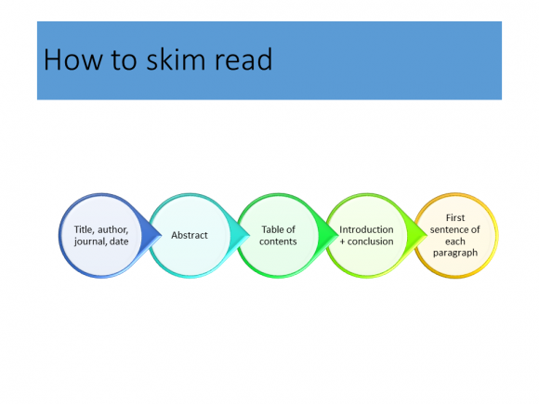
The Other Kinds Of Reading
Skimming:
It involves looking through a text quickly to derive the gist of something. It involves a degree of inference and interpretation.
Notes:
The Other Kinds Of Reading

Slide 11
Passage 1:
Organisations are institutions in which members compete for status and power. They compete for the resources of the organisation, for example, finances to expand their own departments, for career advancement and for power to control the activities of others. In pursuit of these aims, groups are formed and sectional interests emerge. As a result, policy decisions may serve the ends of political and career systems rather than those of the organisation. In this way, the goals of the organisation may give way to favour sectional interests and individual ambitions.

Slide 12
These preoccupations sometimes prevent the emergence of organic systems. Many of the electronic firms in the study had recently created research and development departments employing highly-qualified and well-paid scientists and technicians. Their high pay and expert knowledge were sometimes seen as a threat to the established order of rank, power and privilege. Many senior managers had little knowledge of technicality and possibilities of new developments and electronics. Some felt that close cooperation with the experts in an organic system would reveal their ignorance and show their experience was now redundant.
Notes:
Synopsis of the passage (Core points) –
In organisations, members compete for fulfilling individual ambitions.
Due to the pursuit of individual ambitions, groupism emerges.
Groupism may lead to preventing emergence of organic systems.
Senior managers thus feel their ambitions and progress are threatened by the high pay and expert knowledge of experts.

Slide 13
1. The theme of the passage is ______________.
a. groupism in organisations
b. individual ambitions in organisations
c. frustration of senior managers
d. shortcomings of the established order of rank, power and privilege
Notes:
Answer: Option b
Type of question – Inferential
The ‘theme of a passage’ should be an idea which runs throughout the passage (or) is the core idea based on which the entire passage is built.
By looking at the synopsis given above, it is clear that option b is the idea based on which the entire passage is based.
ELIMINATION OF OPTIONS –
Option a:
Without the need to fulfil individual ambitions, there would be no groupism. Thus option a is dependent on option b, and cannot be the theme of the passage.
Option c:
Frustration of senior managers is mentioned towards the end of the passage, but it is not the main theme. Without individual ambitions, there would be no cause for senior managers to become frustrated.
Option d:
Similar to option c, the shortcomings of the established order is an idea dependent on the presence of individual ambitions.

Slide 14
2. According to the passage, members in an organisation contend with each other for all the following reasons except ______________.
a. authority to regulate the functions of other members in the organisation
b. progress in the careers of the members
c. gaining expert knowledge of technicality and possibilities of new developments
d. capital for expansion of the members’ departments
Notes:
Answer: Option c
Type of question – Referential
Lines 2-4: “They compete for the resources of the organisation......power to control the activities of others.”
“Power to control the activities of others” – Option a
“Career advancement” – Option b
“Finances to expand their own departments” – Option d
Option c clearly does not find a mention in the passage, and is thus the answer.

Slide 15
3. According to the passage, policy decisions in organisations may involve ____________.
a. cooperation at all levels in the organisation
b. modernization of the organisation
c. assisting the objectives of political and career structures in the organisation
d. keeping in view the larger objectives of the organisations
Notes:
Answer: Option c
Type of question – Referential
Lines 5-6: “....policy decisions may serve the ends of political and career systems.”

Slide 16
4. The author makes out a case for _________________.
a. organic systems
b. research and development
c. an understanding between senior and middle level
executives
d. a refresher course for senior managers
Notes:
Answer: Option c
Type of question – Inferential
Inference gained from the last two lines of the passage: “Some felt that close cooperation.....experience was now redundant.”
As per the aforementioned lines,
‘The experts in the organic system’ refers to middle level executives.
Co-operation between the senior managers and the middle level executives would cause discomfort for the managers, who felt threatened by the high level of knowledge and pay the middle level executives possessed.
Thus it can be inferred that in order to solve the problem of discomfort caused by the senior managers, there has to be an understanding between the senior managers and the middle level executives.

Slide 17
5. The author tends to look at the senior managers as __________.
a. ignorant and incompetent
b. a little out of step with their work environment
c. jealous of their younger colleagues
d. robbed of their rank, power and privilege
Notes:
Answer: Option a
Type of question – Referential
Last 4 lines: “Many.....little knowledge of technicality......ignorance and show their experience was now redundant.”

Slide 18
How do we read?
We read at different speeds for different purposes of reading….
Notes:
How do we read?
Habit of reading

Slide 19
Detailed Reading:
Reading for memorization (under 100 words per minute)
Reading for learning (100–200 wpm)
to slow down when the concepts are closer together or when the content is unfamiliar
Notes:
Detailed Reading:
Please talk about different types of reading

Slide 20
Detailed reading:
Reading for comprehension (200–400 wpm) –Important !
the essence of most people’s daily reading
Notes:
Detailed Reading:
Please talk about different types of reading

Slide 21
Skimming: For Getting The Gist Of Something
Skimming (400–700 wpm)
Use skimming when you're trying to decide if a book in the library or bookshop is right for you.
When you're going through a newspaper or magazine in the morning: you read quickly to get the main points, and skip over the detail. Then you rush to your school.
Notes:
Skimming: for getting the gist of something

Slide 22
Scanning: For A Specific Focus
Scanning (more than 700 wpm)
When you're looking up a name in the phone book;
When you’re looking up your name in a lucky draw result list in the newspaper.
Notes:
Scanning: For A Specific Focus

Slide 23
How will you read in these situations?
A poem
A bus timetable
A fax at the office
An advertising email - so called "spam"
An email or letter from your best friend
A recipe
A short story by your favorite author
Notes:
Talk about the different models of reading according to the topic and situations.

Slide 24
Passage 2:
This is a highly unusual paragraph. But, it is up to you to find out how! Go through it again and again; it looks so ordinary that you’d think nothing was wrong with it. Actually, nothing IS “wrong” with it. But I vouch that it IS but unusual. If you sit with it for hours or days, it might dawn on you and you will find out why it is truly so unusual. So, why do you think I am harping in this fashion? It is not all that difficult, if only you know what to look for!

Slide 25


